Slide 1
Integrated Mini-Projects: Connecting CTE & the Next Generation Science Standards
By: Kelly V. Meade

Slide 2
What is CTE?
Career Technical Education
15 Industry Sectors
Career Pathways
Notes:
My CTE industry sector is Health Science and Medical Technology in the Support Services and Diagnostic Services Pathway

Slide 3
The 15 Industry Sectors
Foundation Standards
Academics
Communications
Career Planning and Management
Technology
Problem Solving and Critical Thinking
Health and Safety
Responsibility and Flexibility
Ethics and Legal Responsibilities
Leadership and Teamwork
Technical Knowledge and Skills
Demonstration and Application

Slide 4
Health Science and Medical Technology Industry Sector
Support Services Pathway
Direct/Indirect Patient/Client Care

Slide 5
NGSS – Next Generation Science Standards
Meeting Performance Expectations
Science and Engineering Practices
Disciplinary Core Ideas
Crosscutting Concepts

Slide 6
Projects
Molecules in My Food
Water Purification

Slide 7
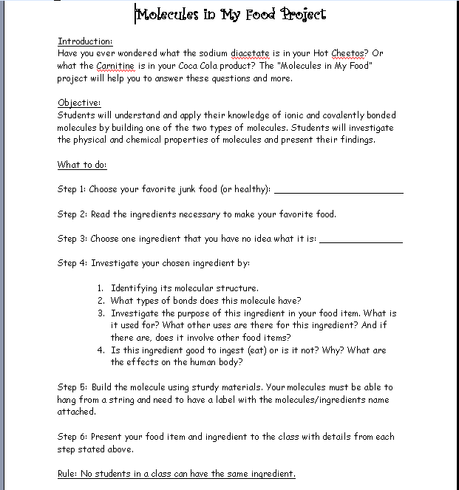
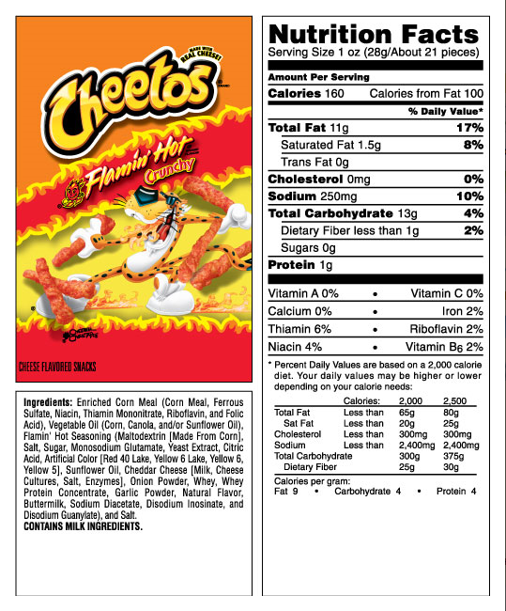
Molecules in My Food

Slide 9
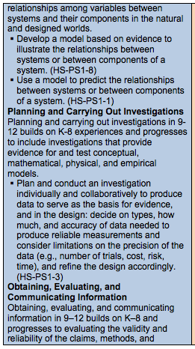
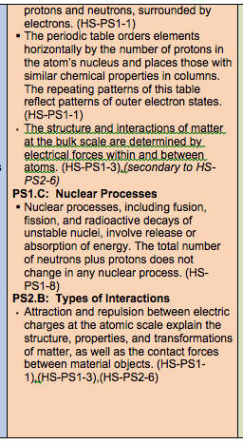
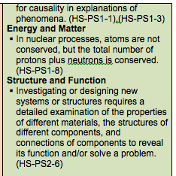
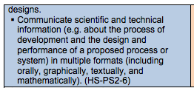

Slide 10
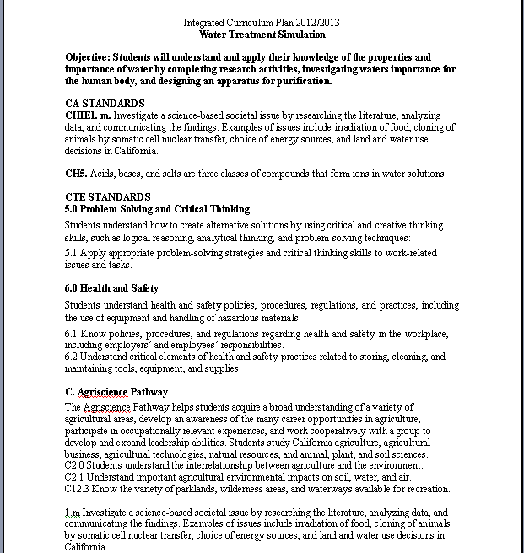
Water Purification
HS – ETS 1.1
Notes:
OUTCOME
Students will research waters use and importance to society and investigate waterborne diseases in undeveloped nations. Working in groups, students will brainstorm the chemicals that regularly end up in the water system by simply going down our sink drains and gutters, as well as lakes and rivers. They will simulate a water treatment and purification process and identify chemical impurities that are still within their foul water sample after their attempt at purification. After attempting the purification process they will discuss their expectations and experiences with the water simulation. Students will work in groups to find solutions to the water disparities of the world.

Slide 12
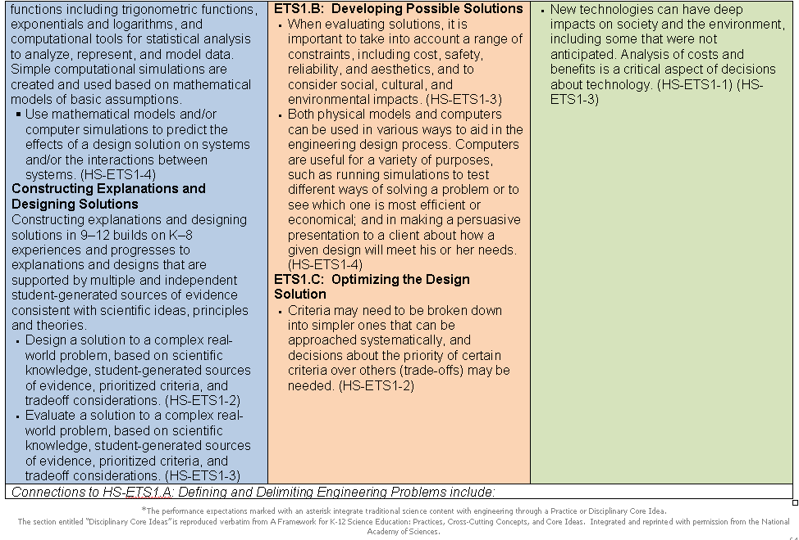

Slide 13
Standard Review & Create
Groups Review of Standards
Mini-Project Brainstorming
Your Ideas??

